Slide 1
Example of programming a quantum robot
This program can be easily changed to the following types of control:
Boolean Logic
Fuzzy logic
Probabilistic logic
Ternary logic
Mixed logic
Your own control for any algebra you may want

Slide 2
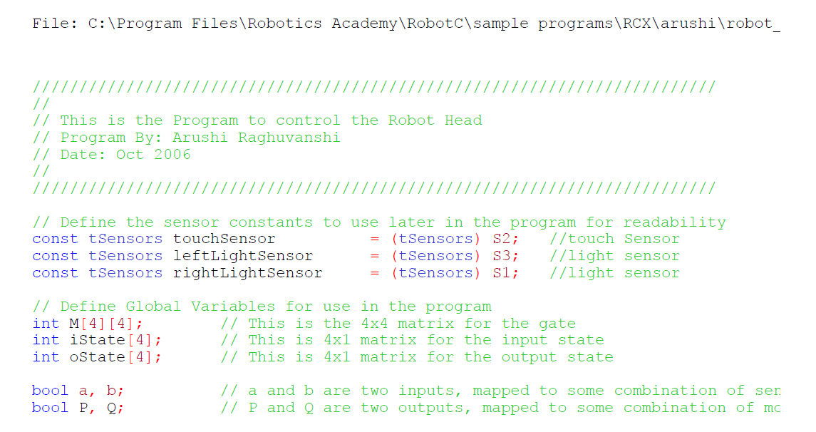

Slide 3
Review matrices and vectors
Review how to multiply matrix by vector
Review how to multiply matrix by matrix

Slide 4
For loop flowchart
}
}
}

Slide 5
For loop flowchart
start
i=0
External loop
Ostate[i]=0
Internal loop
j=0
j=j+1
yes
j < 4
no
i=i+1
yes
i < 4
no

Slide 6
Review quantum measurement
Review probability

Slide 7
For loop flowchart
start
i=0
Ostate[i]=0
j=0
j=j+1
yes
j < 4
no
i=i+1
yes
i < 4
no
end

Slide 8
Initialize total
oneCounter counts ones
Calculate new value of total
Calculate value of output

Slide 9
Continue of subroutine of interpreting the output state
Calculate deterministic values of control variables P and Q
Loop for oneCounter

Slide 10
Translates output Boolean variables P and Q to actions of motors
Output Motion routine is for motors

Slide 11
Converts sensor reading to input variables a and b
Two light sensors and touch sensor
Input routine is for sensors
Two light sensors and touch sensor

Slide 12
Main program links inputs, outputs and brain (behavior)
Intialize all
input
brain
output

